Slide 1
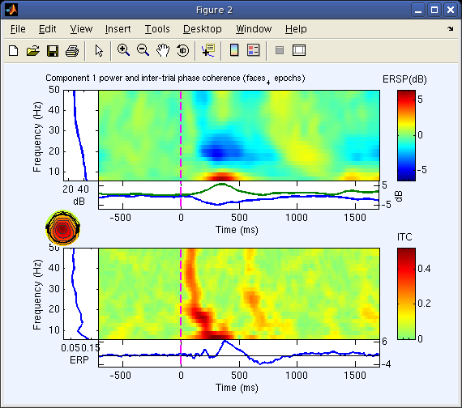
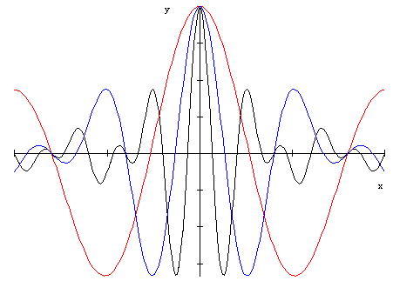
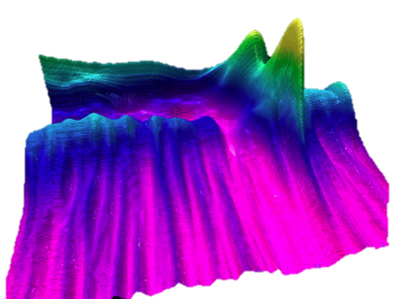



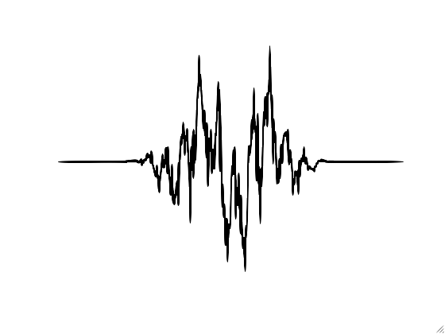
Time-Frequency Analysis of Biophysical Time series
Arnaud Delorme
(with contributions from Tim Mullen and John Iversen)

Slide 2
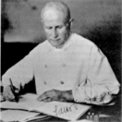
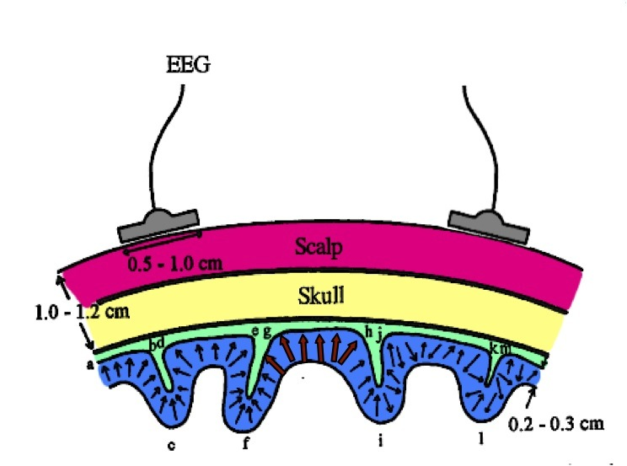
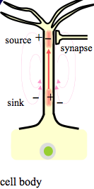

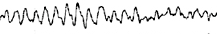
Biophysics of EEG
Volume
Conduction
Hans Berger (1873-1971)
Cortex
Local Field Potential
Synchronicity of cell excitation (due to recurrent cortico-cortical and cortico-thalamo-cortical projections) determines amplitude and rhythm of the EEG signal
Notes:
Hans Berger was to first to record EEG in humans -- specifically the so-called “alpha rhythm” in 1924

Slide 3
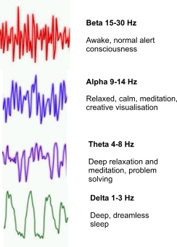

Brain oscillations
EEG

Slide 4
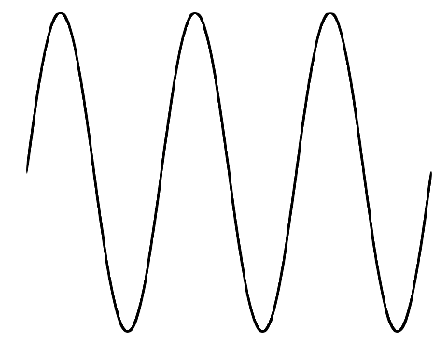
Sinusoids
phase shift
angular frequency
Amplitude
1.2
A=1.2
-1.2
-π/2
0
π/2
π
3π/2
2π
t
Notes:
sin(0) = 0
cos(0) = 1

Slide 5
Wide-sense stationary signals
The first and second moments (mean and variance) of the data distribution do not depend on time.
Notes:
cyclostationary

Slide 6
Wide-sense stationary signals
Cyclostationary signals
2 Hz
10 Hz
Magnitude
Magnitude
Time
Time
20 Hz
2+10+20 Hz
Wide-sense
Stationary
Magnitude
Magnitude
Time
Time
Slide courtesy of Petros Xanthopoulos, Univ. of Florida
Notes:
cyclostationary

Slide 7
Wide-sense stationary signals
2 Hz + 10 Hz + 20Hz
Power spectrum
Wide-sense
Stationary
Magnitude
Magnitude
Time
Frequency (Hz)
By looking at the Power spectrum of the signal we can recognize three frequency
Components (at 2, 10, 20Hz respectively).
Slide courtesy of Petros Xanthopoulos, Univ. of Florida

Slide 8

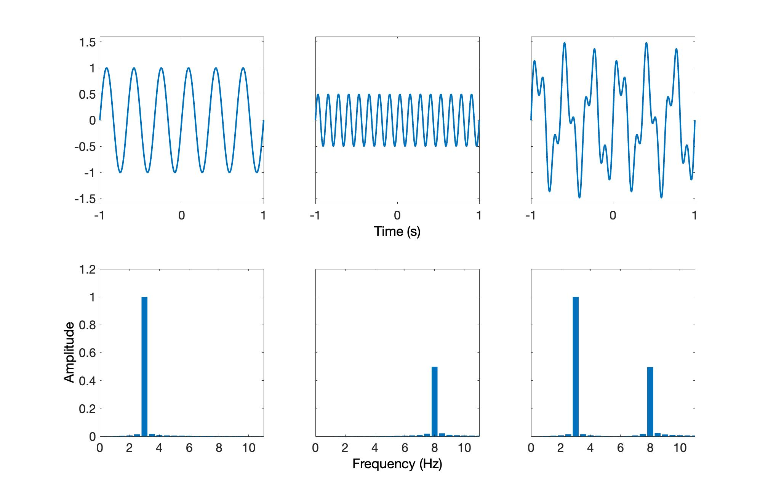
Time and Frequency Domain
Notes:
Based on Euler’s formula, Fourier showed that the total contribution of a sinusoid at frequency f to the original signal can be represented as a convolution of the signal, over all time with a particular complex phasor at the frequency of interest.
Since this phasor is also a complex sinusoid, you can think of power as the covariance between the original time-series and a (complex) sinusoid at some frequency. From a statistical point of view the power at a given frequency is simply the fraction of the variance of the signal which can be explained by a sinusoid at that frequency with a specific phase and amplitude. Thus the sum of the absolute value squared power over all frequencies is equal to the total variance (energy) of the signal.
This also means that we can exactly reconstruct our original signal based on a similar convolution of a complex phasor (here the conjugate) with the frequency domain complex spectrum (Inverse DFT)
The Fast Fourier algorithm is a technique for computing the discrete fourier transform when the number of samples is a power of two. This allows a divide-and-conquer algorithm to be used which dramatically increases computational speed.

Slide 9
Fourier’s Theorem
Any stationary, continuous process can be exactly described by an infinite sum of sinusoids of different amplitudes and phases.
Jean Baptiste Joseph Fourier
(1768 –1830)
Notes:
Fourier’s theorem says that any stationary process can be represented by an infinite sum of sinusoids of different amplitudes and phases.

Slide 10
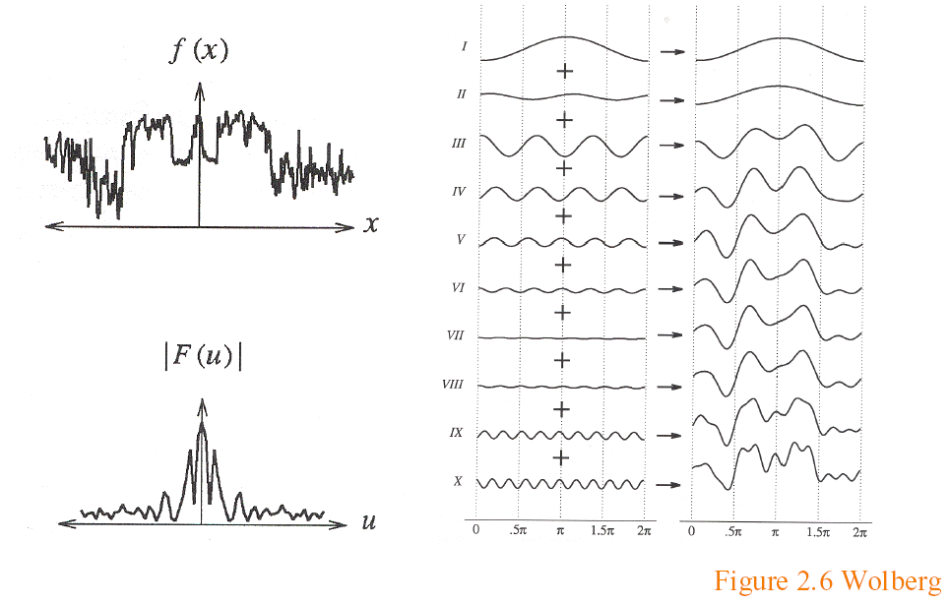
Fourier Analysis
Freq. decomp.
Sum of freq.
Time
domain
x(t)
t
Time
|S(f)|= Power
Frequency
domain
f
Frequency
Figure, courtesy of Ravi Ramamoorthi & Wolberg
Notes:
Consider the time series on the left. As we incrementally add in sinusoids of increasing frequency, each with a specific phase and amplitude, we more precisely approximate the original time series. As the number of sinusoids approaches infinity, we approach an exact reconstruction of the original time series (technically you only need to add in as many sinusoids as there are data samples in the original time series).
The goal of Fourier analysis is learn the correct amplitude and phase for each sinusoid such that their sum reconstructs the original time series.
--------------------------------------------------------
exp(iwt) = cos(wt) + i*sin(wt)
So F(w) = 1/N * sum_t { f(x)*exp(-iwt) } = 1/N * sum_t { f(t)*cos(wt) - i*sin(wt)} → correlation of x(t) with cosine and sine waves at given frequency

Slide 11
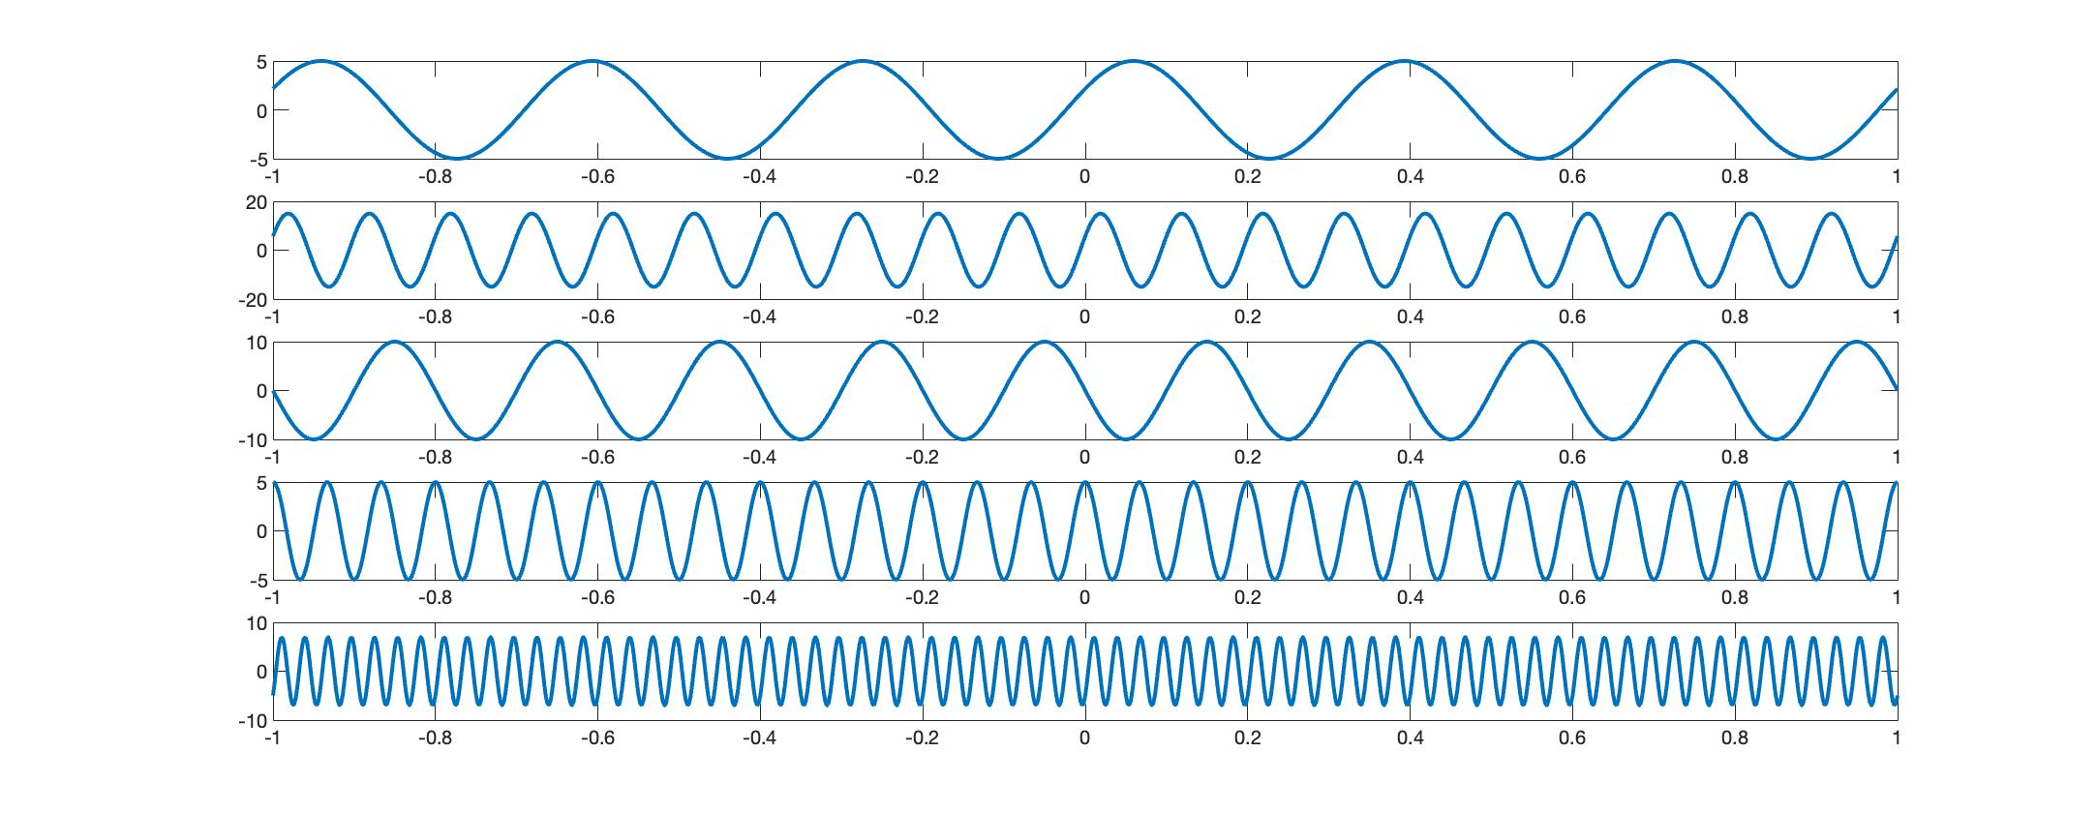
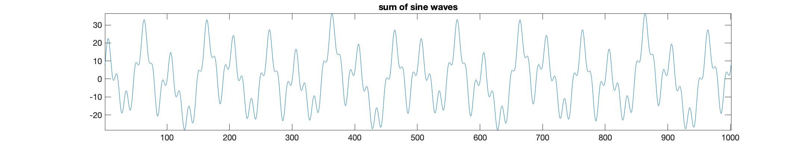
Adding up sine waves

Slide 12
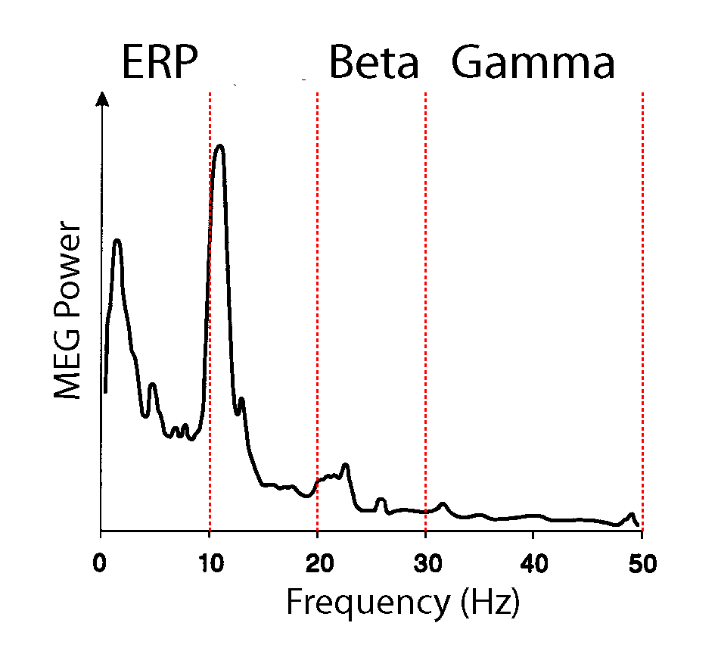
MEEG Spectrum

Slide 13
Aliasing and the Nyquist Frequency
Sampling: f_{s} = 80 Hz
Signal: f = 100 Hz
1 cycle
Alias: f_{alias}(N) = 20 Hz
Nyquist Frequency:
The maximum frequency that can be uniquely recovered at a sampling rate of f_{s}
Quiz: What is N in the
example above?
Notes:
In general, when a sinusoid of frequency f is sampled with frequency Fs the resulting samples are indistinguishable from those of another sinusoid of frequency Falias(N) for any integer N (with Falias(0) being the actual signal frequency).
Most reconstruction techniques produce the minimum of these frequencies (the alias), so it is often important that f be the unique minimum.
A sufficient condition for that is Fs=2Fn where Fn is commonly called the Nyquist frequency (the maximum frequency that can be of uniquely recovered) of a system that samples at rate Fs.
A: N = 1

Slide 14
Euler’s Formula
instantaneous
complex amplitude and phase
phase shift
angular frequency
1.2
any sinusoid can be expressed as the sum of two complex numbers...
A=1.2
-1.2
-π/2
0
π/2
π
3π/2
2π
t
Phase
Another version:
Amplitude
Real part
Cosine component
Imaginary part
Sine component
Phasor
Notes:
A very useful way to represent and operate on sinusoids is the concept of the phasor
Euler’s relation tells us that any sinusoid can be expressed as a sum of two complex numbers, or as the real part of a single complex number called a phasor. This phasor contains all information about the instantaneous amplitude and phase of the sinusoid. So what’s a phasor?
It’s a vector in the polar coordinate system, where the real component is along the abscissa and the imaginary component is along the ordinate. The angle of this phasor w.r.t. to the abscissa is the phase offset of the sinusoidal signal while the length of the vector (the magnitude, or amplitude which, by the pythagorean theorem is the square root of the square of the real part plus the square of the imaginary part) is the amplitude of the sinusoidal signal).
Some simple algebra and trigonometry gets us an alternate version which expresses a phasor as a sum of a cosine and sine waves which together form a complex sinusoid

Slide 15
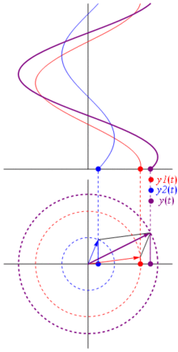
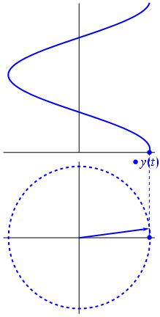
Phasors
Rotation velocity (Rad/S; Hz)
= (angular) frequency (w; f)
Phase
Amplitude
Polar animations courtesy Wikipedia
Notes:
So, we’ve got these phasors– and Euler’s formula let’s us represent our sine wave in cartesian coordinates as the projection onto the real axis of a phasor which is rotating around the circle at a constant speed (angular frequency).
Phasor goes around the circle at some frequency
Instantaneous phase is linearly increasing modulus 2*pi
rotation velocity = angular frequency w=2*pi*f
If we have multiple sinusoids all being summed, then the result in polar coordinates is a phase vector representing the sum of all the individual phase vectors. In general we are given real-valued data which is a sum of a bunch of sinusoids and our goal is to identify the individual complex phasors at each frequency which will tell us the amplitude and phase of each sinusoidal component at every frequency.

Slide 16
Phasors: Example
3
1.2
Imag.
Real
Notes:
So we can compute the complex power by a convolution of the original signal with a complex sinusoid of some frequency. This maps the real-valued signal, which is represented in cartesian coordinate space to a complex number or phasor or phase vector in polar coordinate space.
For instance, on the left we have a sinusoid of relatively large amplitude and with zero phase offset. So the complex phasor is a long vector pointing along the abscissa.
On the right we have a sinusoid of relatively small amplitude and with 90 degree (pi/2) phase offset.
Magnitude=absolute value
Absolute value of a complex number z = x + iy is given by
|z| = Sqrt(x^2 + y^2) which is equal to the distance from the origin of a point in the complex plane.
t = freqs(index)*winval/srate;
p = 2*pi;
s = cycles(index)/5;
wavelet{index} = exp(j*t*p)/sqrt(2*pi) .* ...
(exp(-t.^2/(2*s^2))-sqrt(2)*exp(-t.^2/(s^2)-p^2*s^2/4));

Slide 17
Phasors: Example
3
0.7
Imag.
Real
Notes:
And here we have another example with an even smaller amplitude, but a phase shift that is between 0 and 90 degrees. What will the complex phase vector look like?

Slide 18
Discrete Fourier Transform
Time → Frequency
Frequency → Time
Forward transform
Inverse transform
N = number of samples
Fast Fourier Transform (FFT)
Power reflects the covariance between the original signal and a complex sinusoid at frequency f. Or you can think of it as the proportion of the signal variance explained by a sinusoid at frequency f
Notes:
Based on Euler’s formula, Fourier showed that the total contribution of a sinusoid at frequency f to the original signal can be represented as a convolution of the signal, over all time with a particular complex phasor at the frequency of interest.
Since this phasor is also a complex sinusoid, you can think of power as the covariance between the original time-series and a (complex) sinusoid at some frequency. From a statistical point of view the power at a given frequency is simply the fraction of the variance of the signal which can be explained by a sinusoid at that frequency with a specific phase and amplitude. Thus the sum of the absolute value squared power over all frequencies is equal to the total variance (energy) of the signal.
This also means that we can exactly reconstruct our original signal based on a similar convolution of a complex phasor (here the conjugate) with the frequency domain complex spectrum (Inverse DFT)
The Fast Fourier algorithm is a technique for computing the discrete fourier transform when the number of samples is a power of two. This allows a divide-and-conquer algorithm to be used which dramatically increases computational speed.

Slide 19
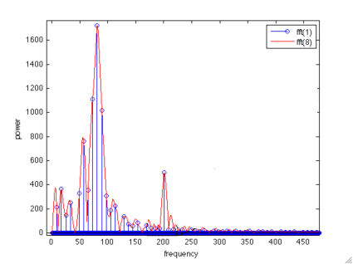
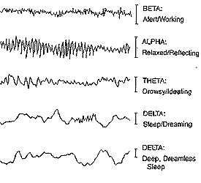
Zero-padding
The DFT/FFT of a sequence of length N produces power estimates at N frequencies evenly distributed between 0 and the sampling rate (Fs), or floor(N/2+1) frequencies between 0 and the Nyquist rate, Fn=Fs/2.
Padding the signal with Q zeros achieves the following:
0…0
0…0
padding
Allows enforcement of signal length as a power of two enabling FFT
Increases the number of frequency bins between 0 and Fs from N to N+Q (intermediate points are sinc interpolates)
Zero-padding does not increase frequency resolution (number of independent degrees of freedom)
Notes:
Zero-padding is generally done to ensure that the signal length is a power of 2, which is required for some efficient FFT algorithms.
This also increases the number of datapoints and thereby increases the number of frequency bins between 0 and the nyquist frequency F_n (each bin is of width F_n/N).
This might be perceived as an increase in the frequency resolution since frequencies which lie between two bins would have their peaks attenuated in the N-point DFT.
Note however, that this does not increase the number of independent degrees of freedom – and thus does not really increase your frequency resolution. For instance if you have two very closely spaced frequencies, and few datapoints, increasing the number of bins will not allow you to distinguish between these peaks. In particular, the best frequency resolution (minimum spacing) you can obtain is going to be 1/T/Fs = Fs/T where T is the number of samples in your unpadded signal.
This also produces a smoother spectrum by interpolating between adjacent frequencies.
The main advantage is that with more frequency bins, there’s a greater chance a frequency of interest lies in the center of one of the bins (however, this can work both ways).

Slide 20
Tapering
Fourier’s Theorem lets us exactly represent any length N, continuous, stationary signal using a weighted sum of N sinusoids. Discontinuous functions must be approximated.
Mitra and Bokil, 2007
Mitra and Bokil, 2007
P_{N}(f)
f
Gibbs Phenomenon
“Rippling” effect due to discontinuities in signal (e.g. edges of the truncated signal)
Infinite number of frequencies required to approximate discontinuities
This means infinite (or very large) number of samples required (not possible)
What can we do?
Notes:
A finite-length signal has discontinuities at the end-points. Zero-padding also produces discontinuities. Fourier analysis only guarantees exact reconstruction of continuous signals – discontinuous functions can be increasingly approximated, as the number of samples increases.
LEFT: Time-domain square wave with discontinuities (N =number of frequencies for approximation). Red = ideal
RIGHT: Frequency response function (N = #samples for approx). Red = ideal (dirac delta function). Approximations, on the right N is the number of samples.
THE ISSUE IS PROBABLY MORE THAT THE SAMPLE LENGTH IS FINITE, RATHER THAN DISCONTINUITIES, per se

Slide 21
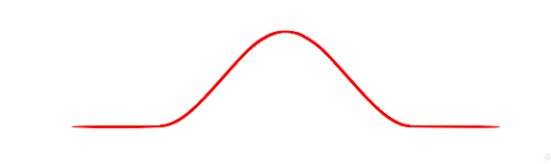
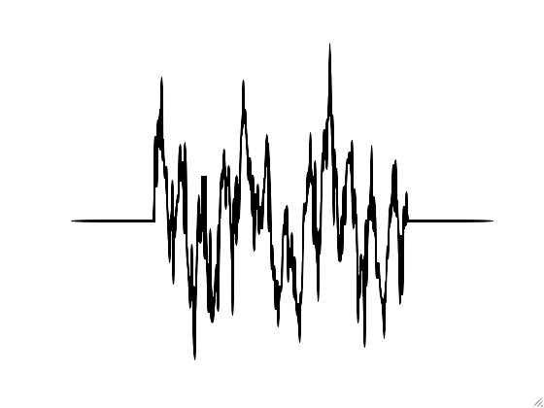
Tapering
Smoothly decay signal to zero at endpoints to smooth discontinuity
1
Taper
EEG
0
X
Tapered
EEG

Slide 22
Windowing
When we pick a short segment of signal, we typically window it with a smooth function (taper).
Windowing in time = convolving (filtering) the spectrum with the Fourier transform of the window
No window (=rectangular window) results in the most smearing of the spectrum
There are many other windows optimized for different purposes: Hamming, Gaussian…

Slide 23
Tapering
Tapering reduces the effect of the Gibbs phenomenon making it easier to identify “true” peaks in the spectrum from spurious ripple peaks (minimized broadband bias or “spectral leakage”)
The cost is increased width of central peak (narrowband bias).
Frequency Response
Fejer kernel
(Triangular taper)
Dirichlet kernel
(no taper)
Amplitude
Frequency
Notes:
The reason that central peak increases in width when sidelobes are suppressed is because the total variance (aka uncertainty, entropy, or energy) must remain constant (integral of the kernel is 1). In suppressing Gibbs ripples we are simply shifting energy/uncertainty out of frequencies distributed over the entire spectrum and into frequencies nearby the central frequency
Another way to see why we get narrowband bias is that the taper is effectively reducing the time window over which we are analyzing the signal – it reduces the amount of data available to us. This reduces our precision in distinguishing between amplitudes for frequencies near the central peak.
We’ll learn more about this later when we discuss the time-frequency uncertainty principle.

Slide 24
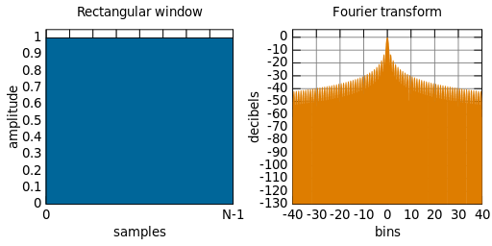
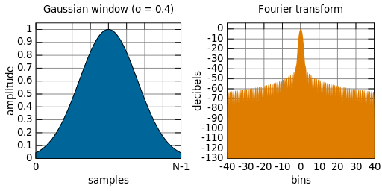
Windows and their Fourier Transforms
Narrowest main peak, but
Highest side-lobes
Most spectral ‘smearing’
Wider main peak, but
much lower side-lobes
Courtesy of John Iversen

Slide 25
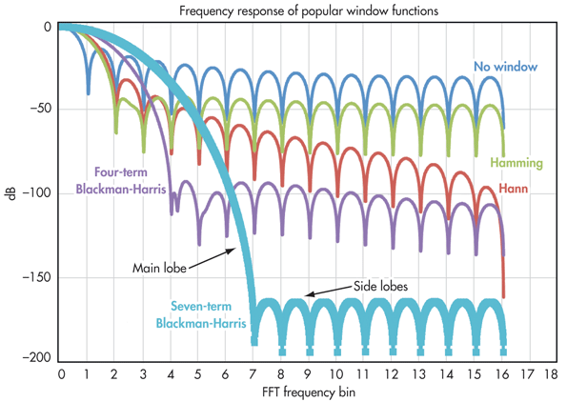
Frequency Responses of Windows
Notice the tradeoff between
sidelobe rejection and
width of main lobe
Courtesy of John Iversen

Slide 26
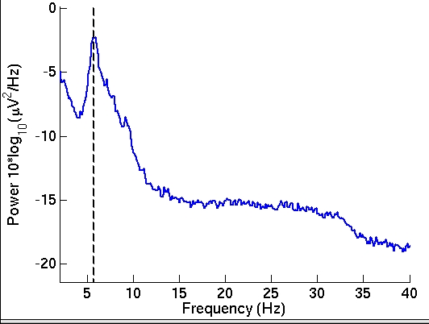
Spectral Estimation via Welch’s Method
EEG
Tapering
FFT
Average of squared absolute values
Given K windows:
Variance is reduced by a factor of K
Frequency resolution also reduced by a factor of K
Tapering also results in data loss → decreased frequency resolution (increased narrowband bias)
Can we mitigate data loss?
Notes:
This is explaining the welch method – windowing and tapering.
We are computing the average length of the phase vectors.
If there are K segments this reduces the total variance in the signal by a factor of K.
It also reduces the frequency resolution by a factor of K

Slide 27
Spectral Estimation via Welch’s Method
EEG
Tapering
Overlap 50%
FFT
…
Average of squared absolute values
Overlap-add method results in reduced data loss due to tapering, while preserving spectral variance reduction ☺
Notes:
This is explaining the welch method – windowing and tapering.
We are computing the average length of the phase vectors.
If there are K segments this reduces the total variance in the signal by a factor of K.
It also reduces the frequency resolution by a factor of K

Slide 28
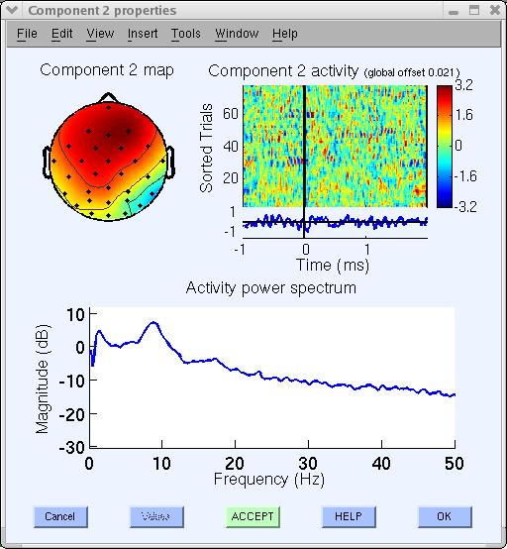
Trial Averaging
0 Hz
10 Hz
20 Hz
30 Hz
40 Hz
50 Hz
Averaging spectra over n independent trials leads to further reduction of variance by a factor of n
Trial 1
Trial 2
…
Trial n
Average of squared amplitude
Power (dB)
Frequency (Hz)
Notes:
Remember that we take the absolute value first before averaging. So the phase is ignored.
We are computing the average length of the phase vectors.

Slide 29
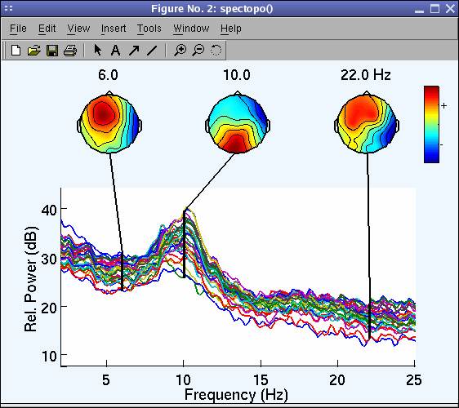
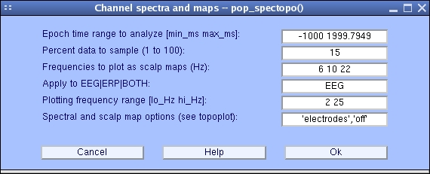
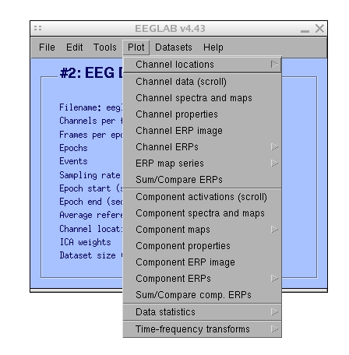
Hands on: Plot periodogram (spectrum) using the Welch’s method
‘winsize’, 256, (in samples; change FFT window length)
‘nfft’, 256, (in samples; change FFT padding)
‘overlap’, 128, (in samples; change window overlap)
1. Use menu item File > Load existing dataset to import the continuous data
ds000117_pruned/derivatives/meg_derivatives/sub-01/ses-meg/meg/wh_S01_run_01_preprocessing_data_session_1_out.set
2. Use menu item Plot > Plot spectra and maps. Plot spectral decomposition with different overlap (‘overlap’), window length (‘winsize’) and FFT length (‘nfft’). The MATLAB command line shows you the values currently used.

Slide 30
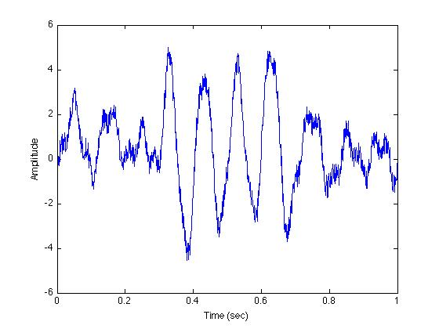
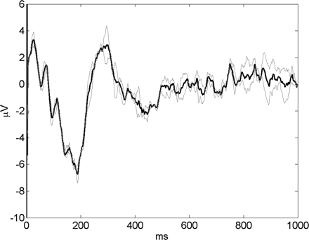
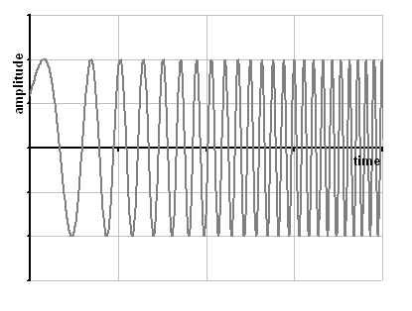
Non-Stationary Signals
Non-stationary signals include bursts, chirps, evoked potentials, …
Burst
Evoked potential
Chirp
Notes:
Up until now we’ve assumed the signals are stationary, which means the statistics of the signal doesn’t change with time. But most electrophysiological signals don’t have this property. For instance, here we have an example of an alpha burst, such as might occur in the lateral visual cortex following presentation of a stimulus. Other examples of nonstationary signals include evoked potentials and chirps.

Slide 31
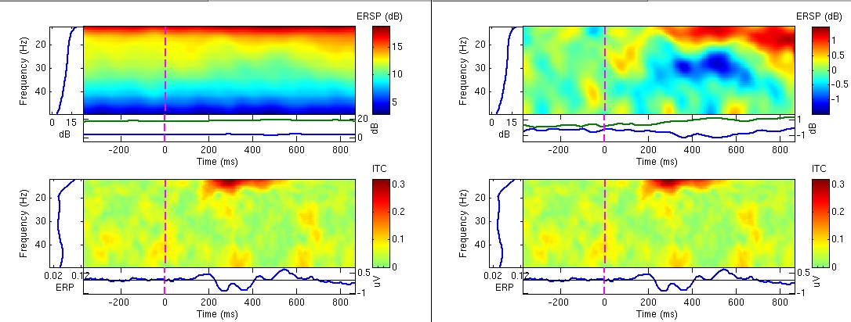
Spectrogram or ERSP
0 ms
10 ms
20 ms
30 ms
40 ms
50 ms
60 ms
5 Hz
FFT
10 Hz
20 Hz
30 Hz
Notes:
We can extend our concept to time-varying analysis, by using a sliding window across our signal. This allows us to produce a spectrogram or time-frequency image of event-related spectral perturbation.

Slide 32
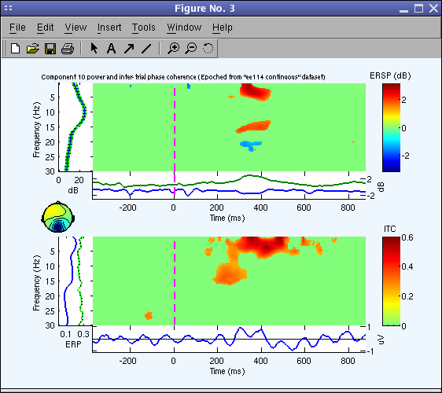
Spectrogram or ERSP
0 ms
10 ms
20 ms
30 ms
40 ms
50 ms
60 ms
5 Hz
Trials
Average of
squared
values
10 Hz
20 Hz
30 Hz
5 Hz
10 Hz
20 Hz
30 Hz
0 ms
10 ms
20 ms
30 ms
40 ms
50 ms
60 ms
Notes:
If we have multiple trials available, we can use ensemble averaging to improve our resolution (reduce bias and variance)
Question for audience: Why can’t we just take the mean over our raw EEG trials first and then obtain the power spectrum (of the ERP)?
A: averaging first (computing the ERP) will eliminate all phase information. So if there is a significant increase in power at some time, but the phases are different across trials, this amplitude increase will average out and we’ll see nothing. Conversely, if we compute the single-trial spectra first, we can extract the single-trial amplitudes (ignoring the differences in phase) and average these.
We’ll discuss this again in greater detail when we talk about inter-trial coherence

Slide 33
Power spectrum and
event-related spectral (perturbation)
Ensemble
average
Complex number
Scaled to dB 10Log₁₀
Here, there are n trials
Each trial is time-locked to the same event (hence “event-related” spectrum)
The ERS is the average power across event-locked trials

Slide 34
Absolute versus relative power
Absolute ERSP
Baselined ERSP (dB or %)
To compute the ERSP, we just subtract the pre-stimulus ERS from the whole trial
Grandchamp R, Delorme A. Single-trial normalization for event-related spectral decomposition reduces sensitivity to noisy trials. Front Psychol. 2011;2:236. Published 2011 Sep 30. doi:10.3389/fpsyg.2011.00236

Slide 35
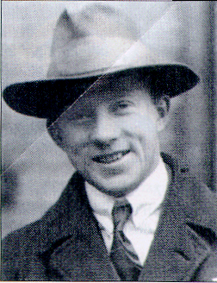
The Uncertainty Principle
A signal cannot be localized arbitrarily well both in time/position and in frequency/momentum.
There exists a lower bound to the Heisenberg product:
Δt Δf ≥ 1/(4π)
or Δf ≥ 1/(4πΔt)
e.g. here are two possible (Δf, Δt) pairs:
Werner Karl Heisenberg
(1901 – 1976)
Δf = 1Hz, Δt = 80 msec or
Δf = 2Hz, Δt = 40 msec
Note: Δf means “difference between successive frequencies” or the inverse of the frequency resolution. Ditto for Δt.
Notes:
Werner Heisenberg 1901-1976, Uncertainty principle, 1927, Nobel Prize, 1932

Slide 36
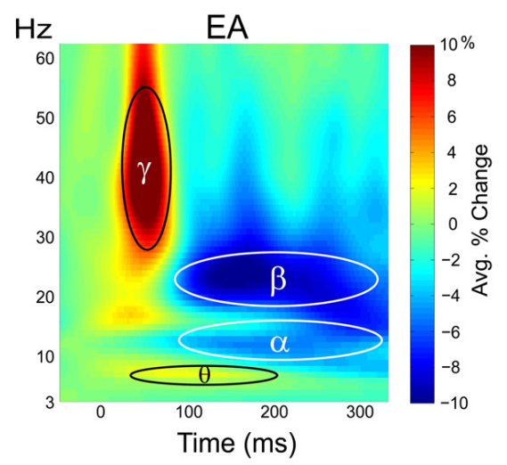
Time-Frequency Tradeoff
Natural biophysical processes may exhibit sustained changes in narrowband low-frequency oscillations along with rapidly-changing (e.g. “burst”) high-frequency oscillations.
The Short-Time Fourier Transform has a constant temporal resolution for all frequencies.
Can we adapt the time-frequency resolution tradeoff for individual frequencies to improve spectral estimation?
Yes, we can!
Witzel, et al, 2011

Slide 37
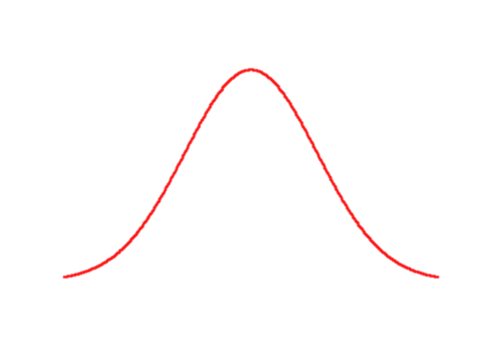
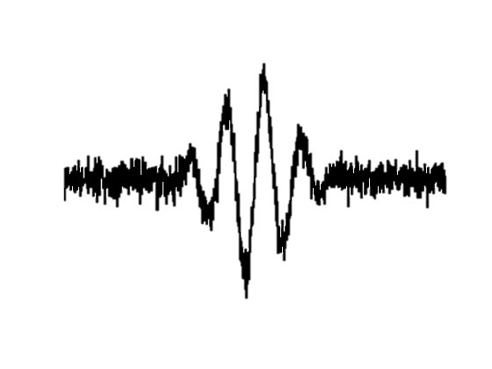
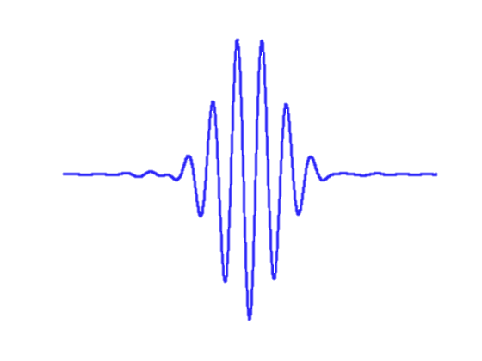
Wavelet Analysis
Complex
Sinusoid
Real Part (cosine)
10 Hz
Imaginary Part (sine)
X
Window
(Taper)
0
time ->
Tapered
sinusoid
(wavelet)
We estimate the time-varying power at 10 Hz by convolving EEG signal with a tapered 10 Hz complex sinusoid (Morlet wavelet)
X
EEG
10 Hz burst
Covariance
Power
|S(f,t)| = |Re + Im|
Notes:
As mentioned earlier, another result of Euler’s formula is that we can equivalently compute the Fourier transform at some frequency by convolving the signal with a complex sinusoid at some frequency of interest.
We can taper our sinusoid – for instance with a gaussian window or some other special function – to localize our wavelet in time and reduce Gibbs rippling due to discontinuities at the endpoints. We can think of this wavelet as a time-frequency “packet” that is localized in frequency and in time (phase).
Then at each time-point we correlate the signal with this wavelet. This given us, for each time point, an estimate of the spectral energy (power) in the signal at that frequency. A key advantage is that we can design each wavelet to be well-localized in time (compact, short sequence) or frequency (the windowing function (taper) spans many oscillations) or to optimize the tradeoff between time and frequency resolution for a given type of signal. The choice of windowing function produces a wide range of wavelets (e.g. Morlet, “Mexican Hat”, etc). EEGLAB currently uses the Morlet wavelet.

Slide 38
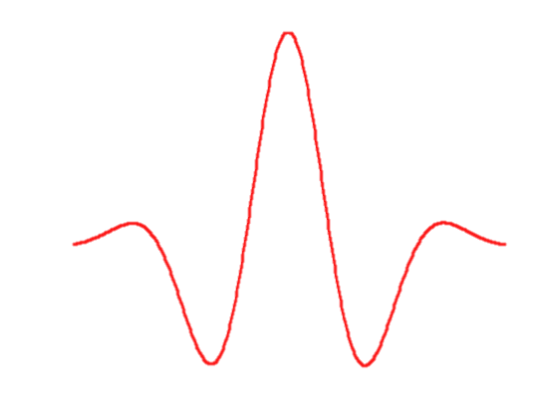
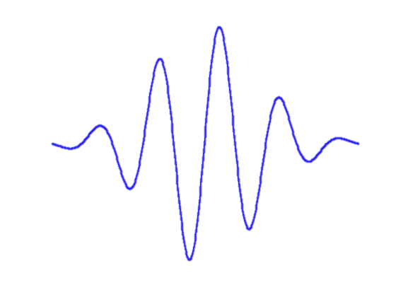
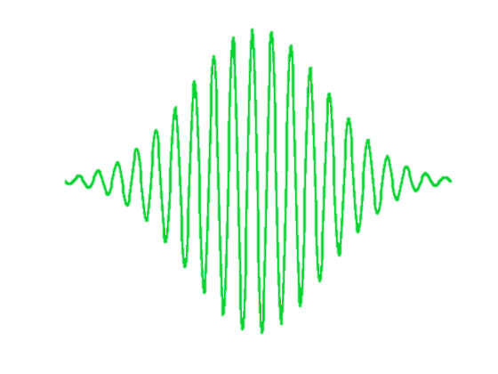
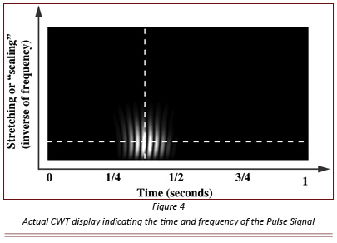
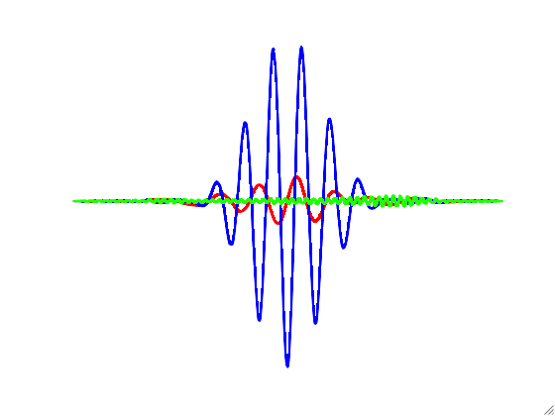
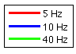
Wavelet Time-Frequency Image
5 Hz
Poor correlation
By convolving stretched and scaled versions of the “mother” wavelet with the EEG signal, we determine the time-frequency distribution of power
Wavelets
10 Hz
Good correlation
40 Hz
Poor correlation
0
Covariance
Max
EEG
10 Hz burst
Frequency
(inverse of scaling)
Cov.
10 Hz
Power
Time

Slide 39
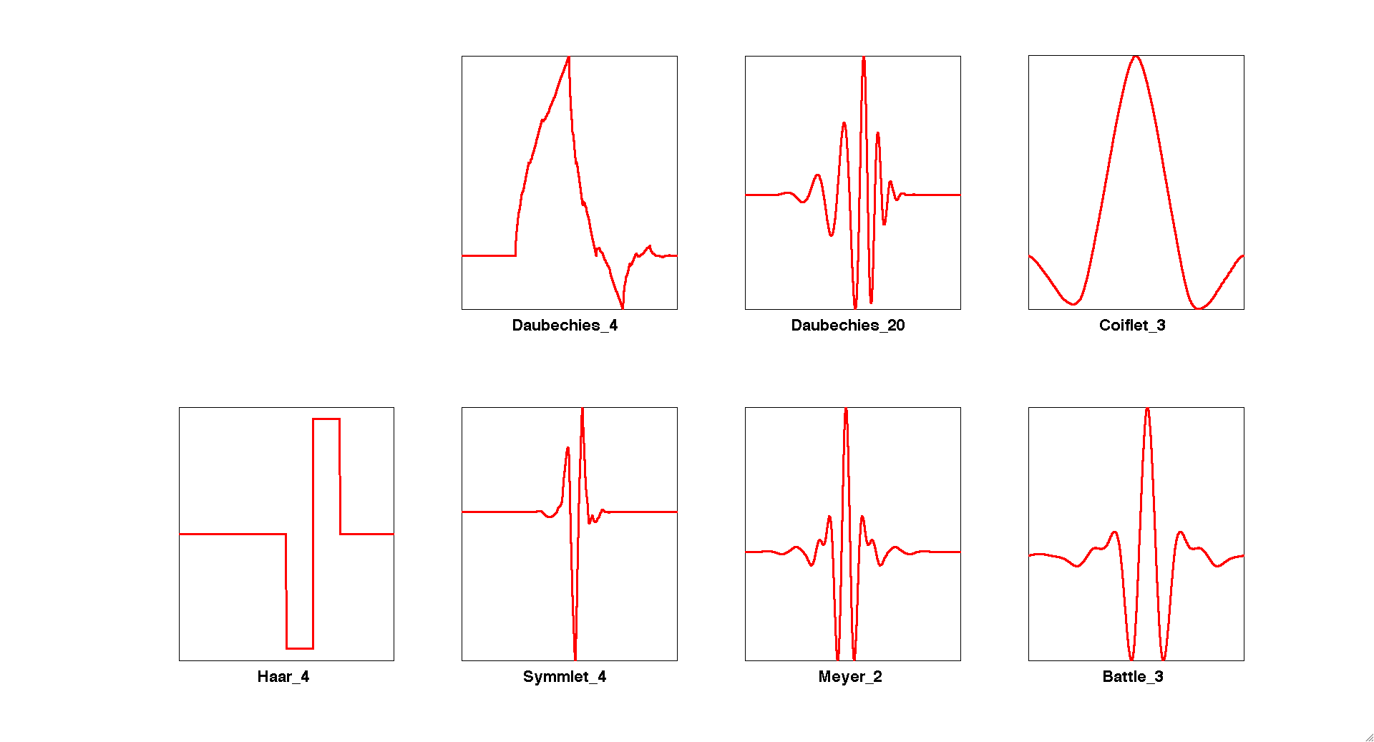
Some Wavelet Families
Morlet
Daubechies_4
Daubechies_20
Coiflet_3
Haar_4
Symmlet_4
Meyer_2
Battle_3
Notes:
different wavelets may be better suited for different kinds of signals

Slide 40
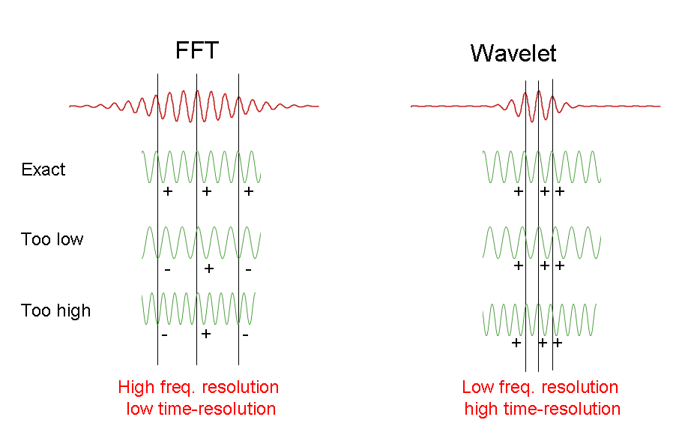


Trading Frequency for Time
(and vice versa)
Wide window
(temporally diffuse)
Narrow window
(temporally compact)
Wavelet
10 Hz
10 Hz
10 Hz
hi corr
hi corr
8.5 Hz
EEG signal
low corr
hi corr
11.5 Hz
low corr
hi corr
High Freq. resolution
Low Time Resolution
Low Freq. resolution
High Time Resolution
Notes:
As we said earlier, there is always a tradeoff between time and frequency.
A wavelet is a “packet” of energy localized in time and frequency. The “width” of the wavelet – e.g. the standard deviation of the gaussian windowing taper for the Morlet wavelet -- determines how accurately a change in amplitude can be localized in time.
Let’s consider two Morlet wavelets: one with a wide window and one with a narrow window. Both have the same central frequency of 10Hz.
If we apply the wide-window wavelet (left) to a 10 Hz EEG signal we’ll find a perfect correlation (all the peaks match up) and high power at 10Hz. The same is true for the small-window wavelet (right)
[Next Row]
Now, if the EEG frequency is at 8.5 Hz -- slightly lower than the wavelet frequency -- then the large-window wavelet (left) will indicate poor correlation/power at 10 Hz since only central peaks match and peripheral peaks are anti-correlated. This is what we should expect.
However, the small-window wavelet will still indicate spuriously high correlation/power at 10 Hz (all the peaks line up).
[Next Row]
Similarly, if the EEG frequency is at 11.5 Hz -- slightly higher than the wavelet frequency -- then the large-window wavelet (left) will indicate low correlation/power at 10 Hz but the small-window wavelet will produce spuriously high correlation.
Thus the wide-window wavelet is better able to localize the amplitude of the signal in frequency, but less able to localize the signal in time, compared to the narrow-window wavelet.
---------------------------------------------------------------------------------------------------
NOTES:
---------------------------------------------------------------------------------------------------
The scale refers to the width of the wavelet. As the scale increases and the wavelet gets wider, it includes more of the time series, and the finer details get smeared out. The scale can be defined as the distance between oscillations in the wavelet (e.g. for the Morlet), or it can be some average width of the entire wavelet (e.g. for the Marr or Mexican hat).
The period (or inverse frequency) is the approximate Fourier period that corresponds to the oscillations within the wavelet. For all wavelets, there is a one-to-one relationship between the scale and period. The relationship can be derived by finding the wavelet transform of a pure cosine wave with a known Fourier period, and then computing the scale at which the wavelet power spectrum reaches its maximum.
For some wavelets the period has more meaning than others. For the Morlet, which has several smooth oscillations, the period is a well-defined quantity which measures the approximate Fourier period of the signal. For the Daubechies, which has irregularly-spaced oscillations, the period has less meaning and should probably be ignored.

Slide 41
FFT versus Wavelets
Time series:
fixed time res
no freq res
Fourier transform:
fixed freq res
no time res
high time res
low freq res
ST Fourier:
fixed time res
fixed freq res
Wavelet:
variable time res
variable freq res
equal time and freq resolution
equal time and freq resolution
Adapted from http://www.cerm.unifi.it/EUcourse2001/Gunther_lecturenotes.pdf, p.10
Notes:
A primary difference between FFTs and Wavelets is that with the Wavelet we can adapt the width of the wavelet (and consequently time resolution) to the frequency of interest, which produces better time-frequency resolution tradeoffs
------------------------------------------------------------------------------------------------------------------------
Example: suppose we have a sinusoid that alternates between N and N+1 Hz every other cycle. For a low-frequency oscillation (small N), changes in power will occur slowly. And since we need at least one cycle of data to estimate the power, our time-resolution will be relatively poor. However, assuming or sampling rate is quite a bit larger than N, we will have many datapoint in a single cycle of the oscillation and so our frequency resolution will be quite high (it will be easy to discriminate between power at N versus N+1 Hz, for example). Conversely, for a high-frequency oscillation (large N), changes will occur very rapidly so we must use a very small window to track the changes in power. However with a fixed sampling rate this means we will have far fewer datapoints per cycle and thus we will likely get a poor estimate of the oscillation frequency. This means it will generally be difficult to discriminate between power in neighboring frequencies (e.g. N vs. N+1). We cannot have optimal localization in both time and frequency.
NOTE: can demonstrate this with an illustration…

Slide 42
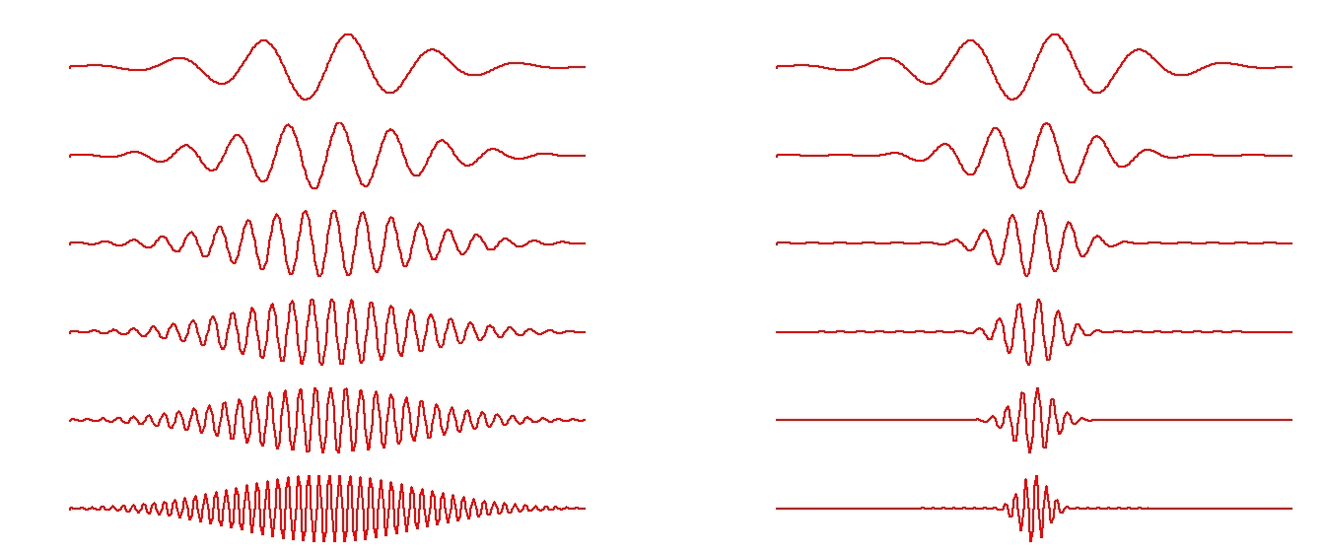
Wavelet scale expansion factor
Wavelet (0)
Wavelet (1)
Scale
scale expansion factor (q)
1Hz
2Hz
4Hz
6Hz
8Hz
10Hz
constant window size (time resolution) for increasing frequency → increasing # cycles with frequency.
window size decreases by a factor of 2 for each octave (power of 2) → constant # of cycles at each frequency
Notes:
In EEGLAB we all the use to set a parameter that automatically adapts the time-frequency resolution by adjusting the width of the Morlet wavelet with frequency. This is called the scale expansion factor.
[LEFT] A scale expansion factor of 0 is equivalent to a tapered STFT – we keep the window size (time resolution) constant for all frequencies (thus increasing # cycles within window for increasing frequency). This produces a constant time-frequency tradeoff for all time points and frequencies.
[RIGHT] On the other extreme, a scale expansion factor of 1 decreases the window size by a factor of 2 for each frequency octave (power of 2) – thus corresponds to maintaining a constant # of cycles at each frequency. This produces high time resolution and low frequency resolution for high frequencies and vs. versa for low frequencies.

Slide 43
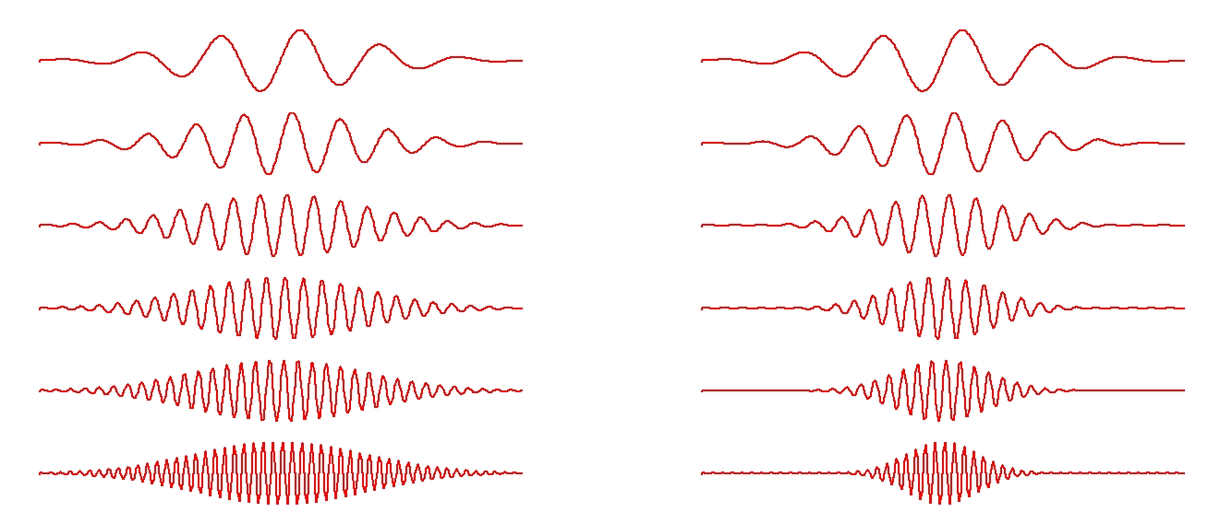
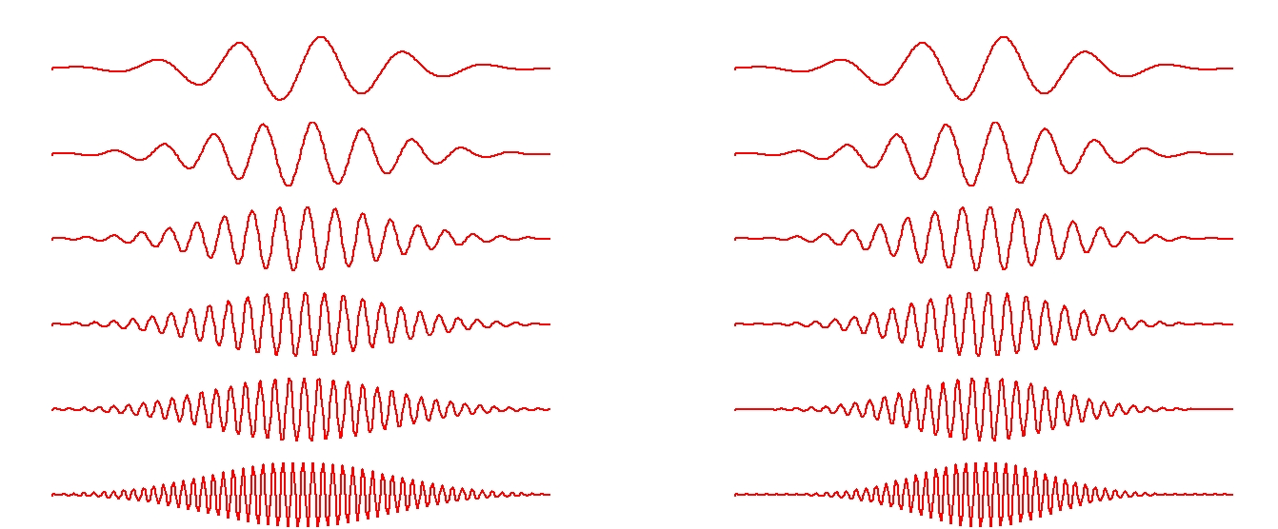

Wavelet scale expansion factor
Larger expansion factor produces larger scale decrements (increased time resolution, lower frequency resolution) for increasing frequency
Wavelet (0.8)
Wavelet (0.5)
Wavelet (0.2)
Frequency
Number of cycles at highest frequency for an expansion factor of q:
Notes:
q = expansion factor
Cinc = [(fmin+1)/fmin] * Cmin * (1-q) = [1- 1/fmin] * Cmin * (1-q) = [ (1-q) – (1-q)/fmin ] * Cmin

Slide 44

Wavelet scale expansion factor
Wavelet(0)
(STFT)
In between
Wavelet (1)
scale expansion factor (q)
Notes:
A small scale expansion factor (or STFT) produces a constant time-frequency tradeoff for all time points and frequencies.
A large scale expansion factor produces high time resolution and low frequency resolution for high frequencies and vs. versa for low frequencies.

Slide 45

Phase
Resetting
Induced Response
Evoked Response
Slide courtesy of Stefan Debener
Notes:
It’s important to consider that am event-related change in trial-averaged power (ERSP) need not correspond to a similar change in time-domain trial average (ERP).
Changes in event-related oscillations and generally classified as either induced or evoked.
1) [LEFT] Induced Response: increased oscillation amplitude, but phases from trial to trial are random. These phase differences will produce an event-locked time-domain average (the ERP) which is close to zero, even though the power is quite large [NOTE: this is because the power ignores the phase differences an considers only the change in amplitude]
2) [RIGHT] Evoked Response: increased oscillation amplitude, but phases from trial-to-trial are the same w.r.t. to the stimulus. This can be due to phase-reorganization of ongoing oscillations (phase reset) by the stimulus. This would give rise to exactly the same power density as the induced case, but we would also see a large time-domain ERP.
We need a way to measure the degree to which oscillations are phase locked to some common event across trials i.e. the portion of the ERSP that can be explained by a “classic” ERP response
---------------------------------------
Power != ITC
Power can remain constant while ITC changes dramatically.
On the left we have high power, since each individual trial shows large amplitude modulation around the event, but there is no ERP or ITC because amplitude modulations are not phase locked to the event.
On the right we have same power, but also high ITC and high ERP, since individual trials have amplitude modulations phase-locked to the event (e.g. phase resetting)

Slide 46
Inter-Trial Coherence (ITC)
Tallon-Baudry, et al, 1996
t
Trial 1
0.5
amplitude 0.5 phase 0
Trial 2
1
amplitude 1 phase 90
Trial 3
.25
amplitude 0.25 phase 180
POWER = mean(amplitudes² )
ITC = |mean(norm’d phase vectors)|
0.44 or –8.3 dB
Magnitude: 0.33
>> EEG = pop_newtimef(EEG,..., ’plotitc’,’on’);

Slide 47
Phase
Resetting
Slide courtesy of Stefan Debener
Notes:
Point here: ITC measures the degree to which oscillations are phase locked to some common event across trials.
LEFT: Phases are random from trial to trial → Low ITC
RIGHT: Phases are similar from trial to trial → High ITC

Slide 48



Plot IC ERSP
Notes:
the [3 0.5] means 3 cycles at lowest frequency with a wavelet factor of 0.5 (12.8 cycles at the highest frequency (50 hz).

Slide 49

Mask IC ERSP
Pure green denotes
non-significant points
0.01

Slide 50


Plot IC ERSP
padratio = 1
padratio = 2
Increase
# freq bins

Slide 51


Plot IC ITC
Shows the actual
dominant phase
of the signal
‘plotphase’, ‘on’

Slide 52



To visualize both low and high frequencies
freqs = exp(linspace(log(1.5), log(100), 65));
cycles = [ linspace(1, 8, 47) ones(1,18)*8 ];
Cycles
Frequencies
1 2 3 4 5 6
1 2 3 4 5 6

Slide 53


Hands-on: Display ERS vs ERSP, change parameters
1. Use menu item File > Load existing dataset to import epoched file for famous stimuli
ds000117_pruned/derivatives/meg_derivatives/sub-01/ses-meg/meg/wh_S01_run_01_ERP_Analysis_Session_2_famous_out.set
Use menu item Plot > Time-frequency transforms > Channel time frequency
2. Plot event-related Spectrogram
(no baseline)
3. Plot event-related Spectral Perturbation
4. Try changing parameters window size, number of wavelet cycles, padratio,

Slide 54
The end

Slide 55




Event Related Spectral Perturbation (ERSP)
Makeig, S. (1993) Auditory event-related dynamics of the EEG spectrum and effects of exposure to tones. Electroencephalogr. Clin. Neurophysiol. 86, 283–293
10 log10(ERS)
Baseline correction
Frequency (Hz)
Time (ms)
Time (ms)
Deux modèles:
Modèle additif:
EEG(après stimulus) =
EEG(non liée au stimulus)
+
EEG(liée au stimulus)
Tallon-Baudry et al. (1996, 1999)
Modèle de gain:
EEG(après stimulus) =
EEG(non liée au stimulus)
x
EEG(liée au stimulus)
Delorme and Makeig (2004)
Notes:
A l’aide des decomposition temps fréquence on a pu étudier les variation de puissance spectrale à la fois dans le temps et pour des différentes bandes de fréquences. Ceci permet d’étudier des phénomène cérébraux en réponse à un stimulus ou une tâche cognitive. Afin de mettre en évidence ces phénomènes, on effectue une moyenne de l’ensemble des essais aligné par rapport à l’affichage d’un même type de stimulus (par exemple si on s’interesse au traitement des informations visuelles par le cerveau, la présentation d’une image).
ERS pour la fréquence f et le temps t = moyenne sur les essais du Carré du module de la transformée de Fourier pour la fréquence f et le temps t.
Cependant, afin de mieux contraster l’activité post-stimulus de l’activité pré-stimulus et de faire ressortir les phénomènes spécifique au traitement du stimulus, on applique classiquement une correction par rapport à la ligne de base, la ligne de base etant définie comme la période pré-stimulus. Des calculs statistiques permettent d’identifier les zones ou pixels de la décomposition temps-fréquence pour lequel l’activité cérébrale est significativement différente de celle de la ligne de base pour la même bande de fréquence.
ERS: Event-related spectrum

